Slide 1
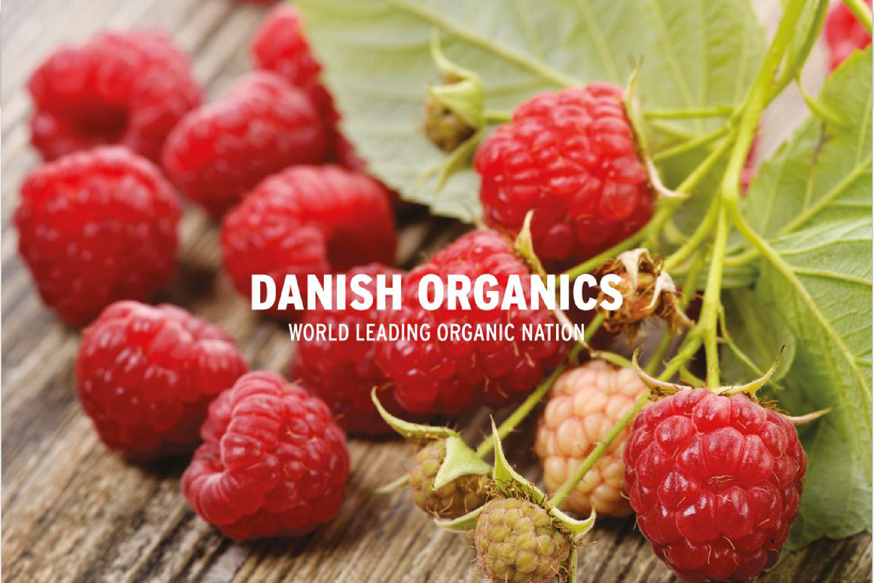
………………………………………………………………………………………………………………………………………..

Slide 2
The Danish Model:
The political and market mobilization driving the organic breakthrough
Per Kølster, chairman
Paul Holmbeck, Political Director Økologisk Landsforening/Organic Denmark
Presented UK Organic Congress 2018
November 16, 2018
………………………………………………………………………………………………………………………………………..

Slide 3
Organic Denmark
Who we are
How we drive market growth in Denmark
Political Policy as catalyst for organic farming & food
Our focus on people: motivation!

Slide 4
Strategic work with all retailers & food service
All consumer info, PR, presse
Export promotion, export academy
Innovation on farms; advisory service
Political lobby work
Organic Farmers
Food Companies
Food Pro- fessionals
Consumers and knowledge workers

Slide 5
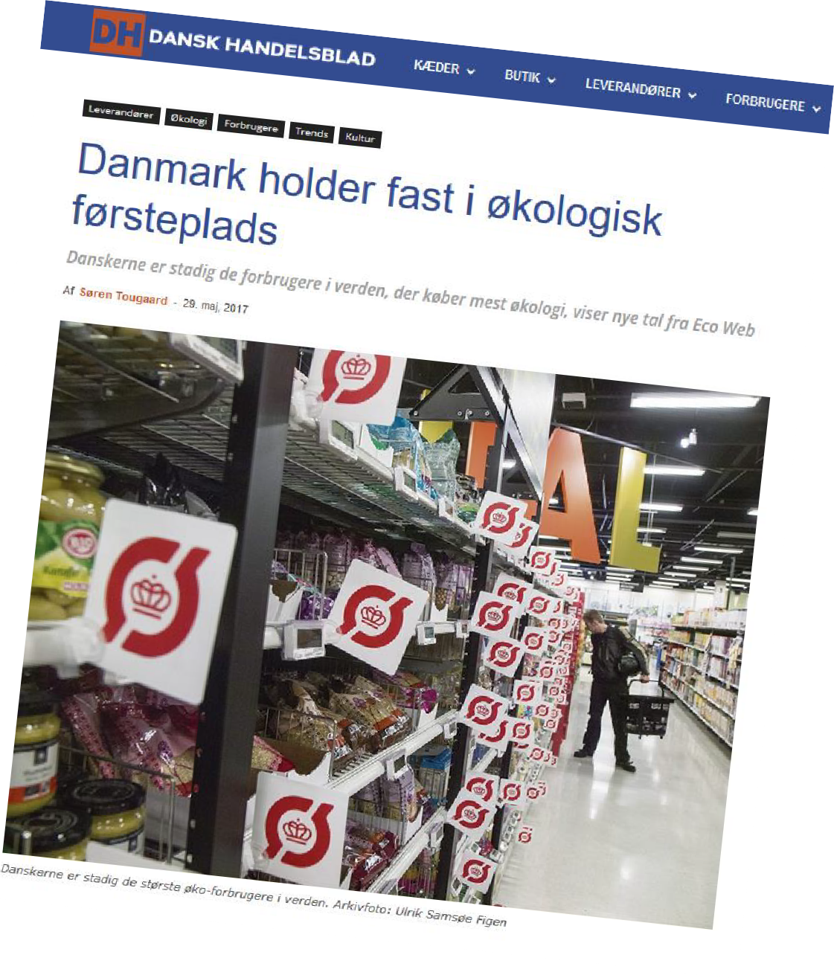
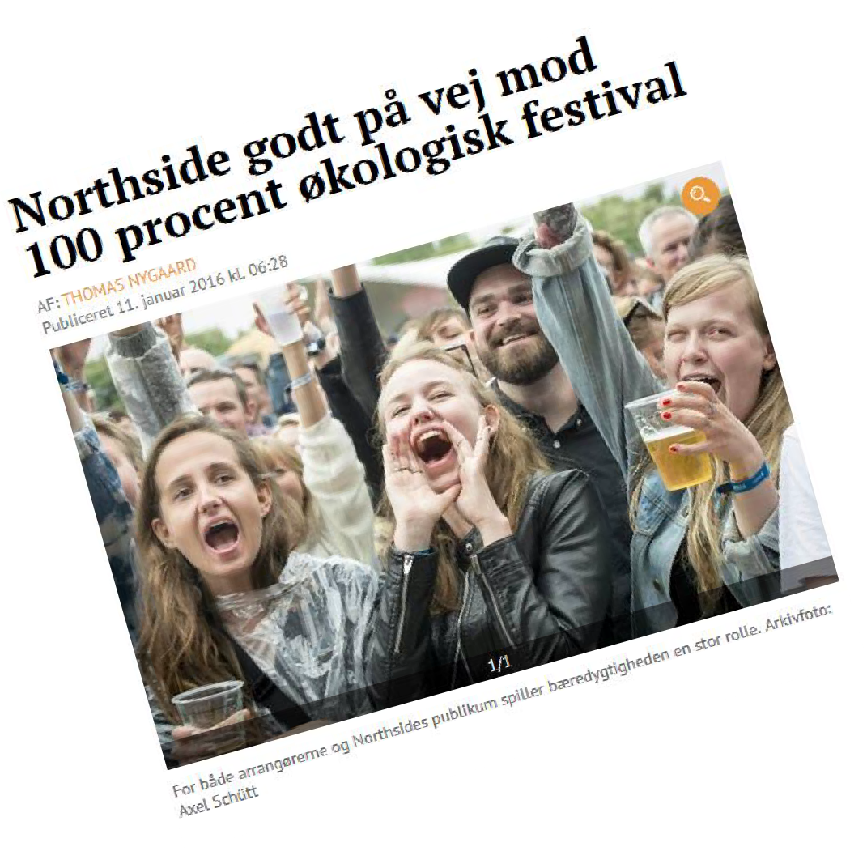
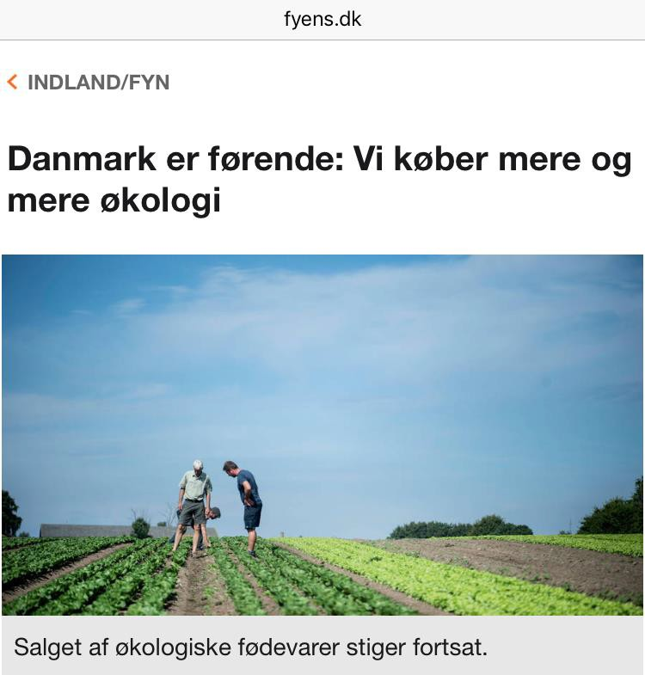
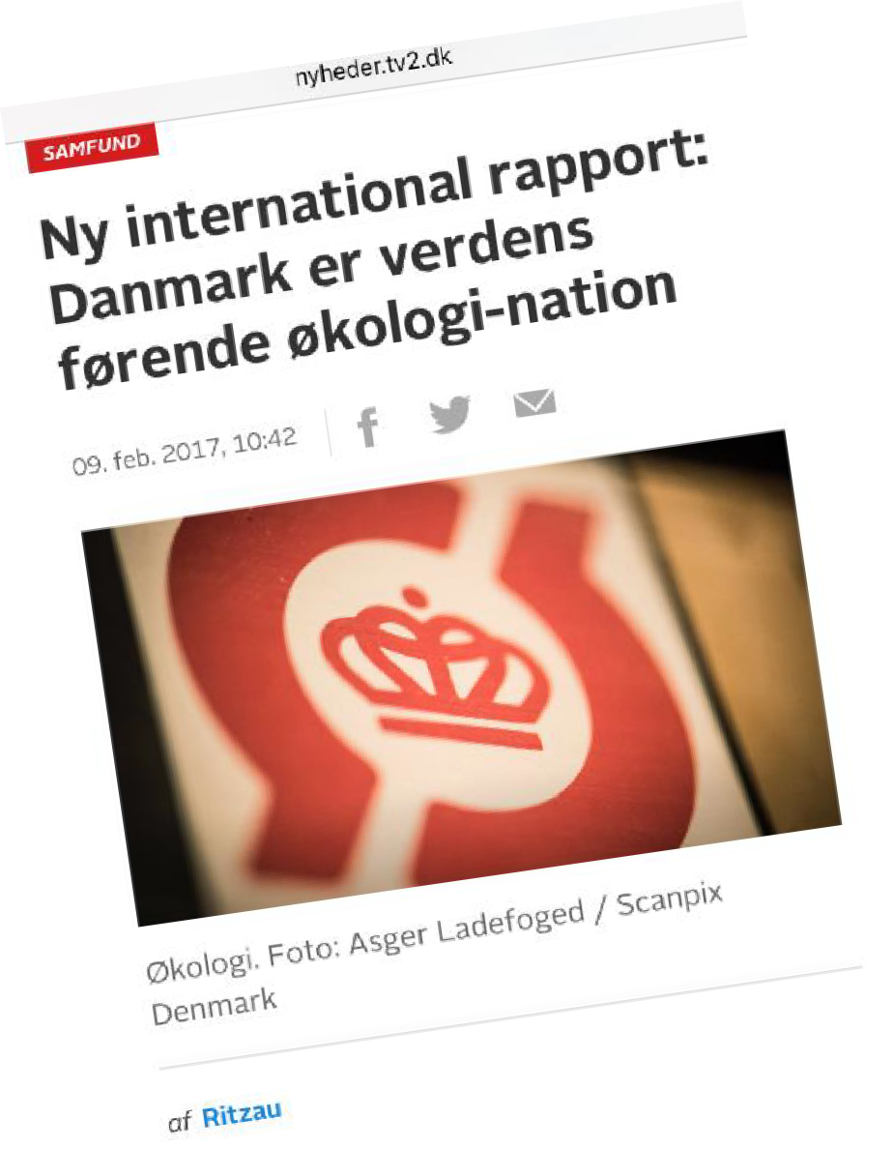
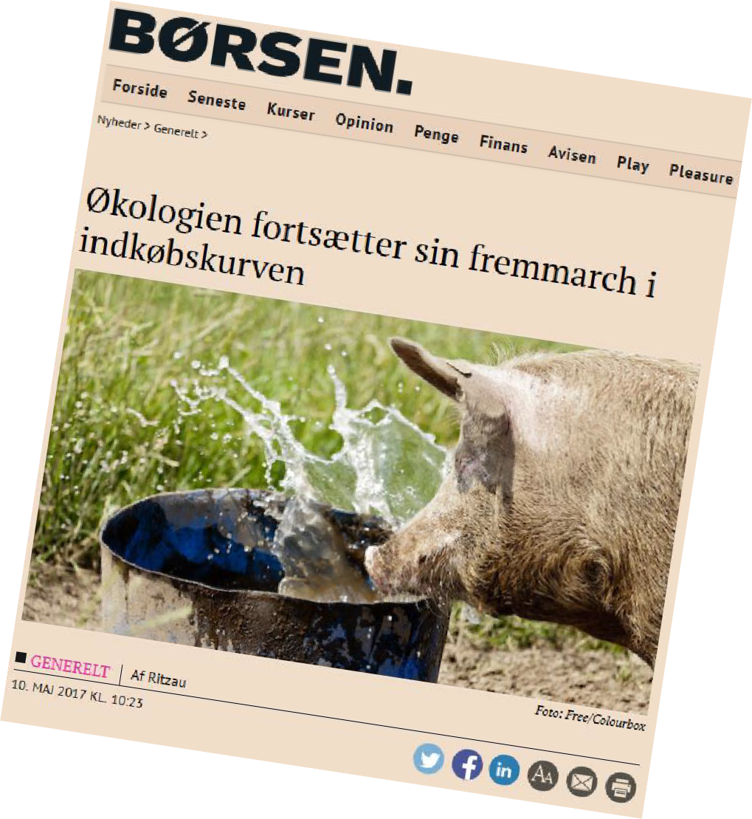
DANMARK IS GOING ORGANIC
………………………………………………………………………………………………………………………………………..

Slide 6
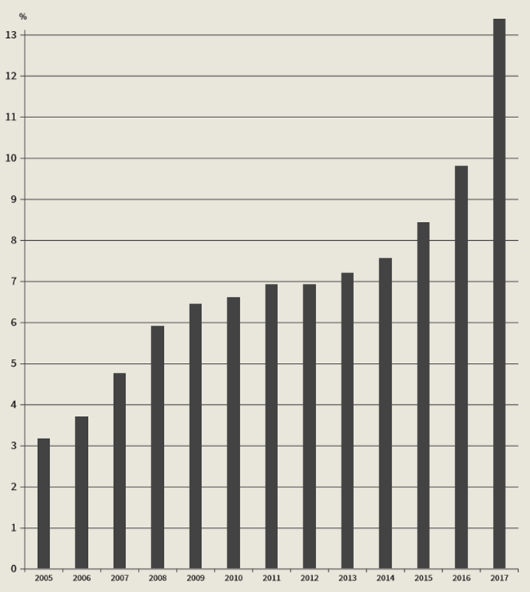
Rapid development in organic market share (DK)
………………………………………………………………………………………………………………………………………..
Kilde: Økologisk Landsforening og Danmarks Statistik

Slide 7
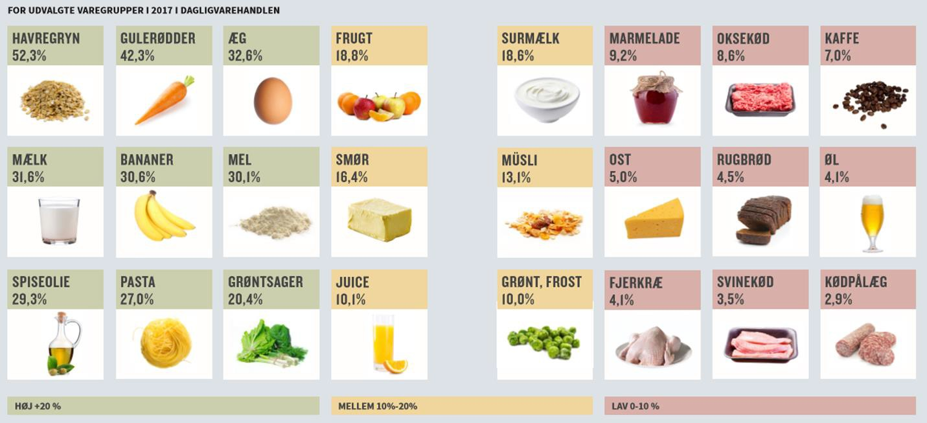
Organic sales in public/private food service (DK)
………………………………………………………………………………………………………………………………………..
Kilde: Økologisk Landsforening og Danmarks Statistik

Slide 8
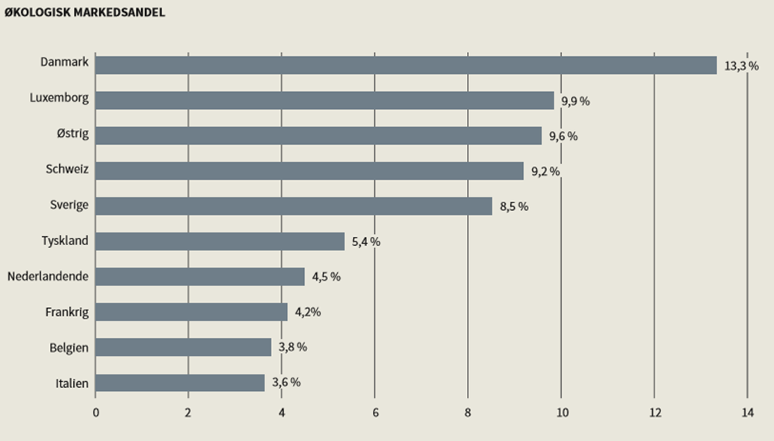
Worlds highest organic market share (DK)
………………………………………………………………………………………………………………………………………..
Kilde: Økologisk Landsforening og Danmarks Statistik

Slide 9
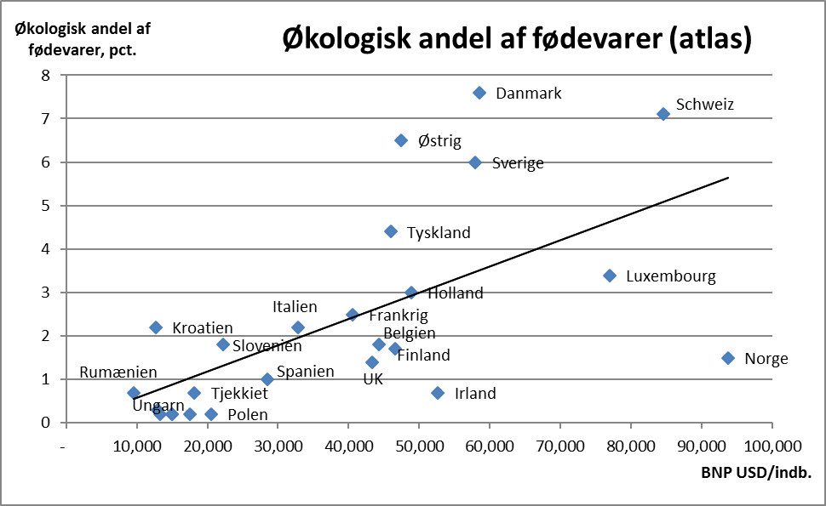
Organic market share relative to country BNP
Aske Skovmann Bosselmann, IFRO, University of Copenhagen, 2017
………………………………………………………………………………………………………………………………………..

Slide 10
Growth in organic sales in public & private food service kitchens
2,5
2,044
2
1,711
1,5
1,43
1,304
Mia. DKK
1
0,981
0,867
0,747
0,519
0,5
0
2010
2011
2012
2013
2014
2015
2016
2017
………………………………………………………………………………………………………………………………………..

Slide 11
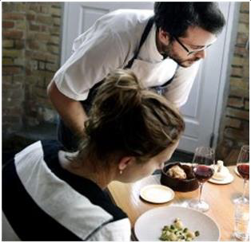
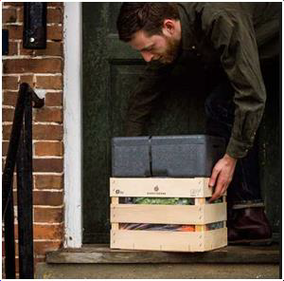
Expected growth in 2018
14%
25%
30%
Supermarkets
Food service
On line sales

Slide 12
This did not happen on its own!
Policy & market collaboration drives growth
Some lessons and examples
………………………………………………………………………………………………………………………………………..

Slide 13
Over the last 25 years:
All major organic policy initiatives have been launched through an active, direct collaboration between the organic NGO and politicians.
Quality and effect of policy depends on quality of dialogue and collaboration between ministry officials and the organic NGO, and ministry willingness to invest in capacity building.
………………………………………………………………………………………………………………………………………..

Slide 14
The why
Ask not what your country can do for organics.
Ask what organics can do for your country.
All political parties.
All organisations.
………………………………………………………………………………………………………………………………………..

Slide 15
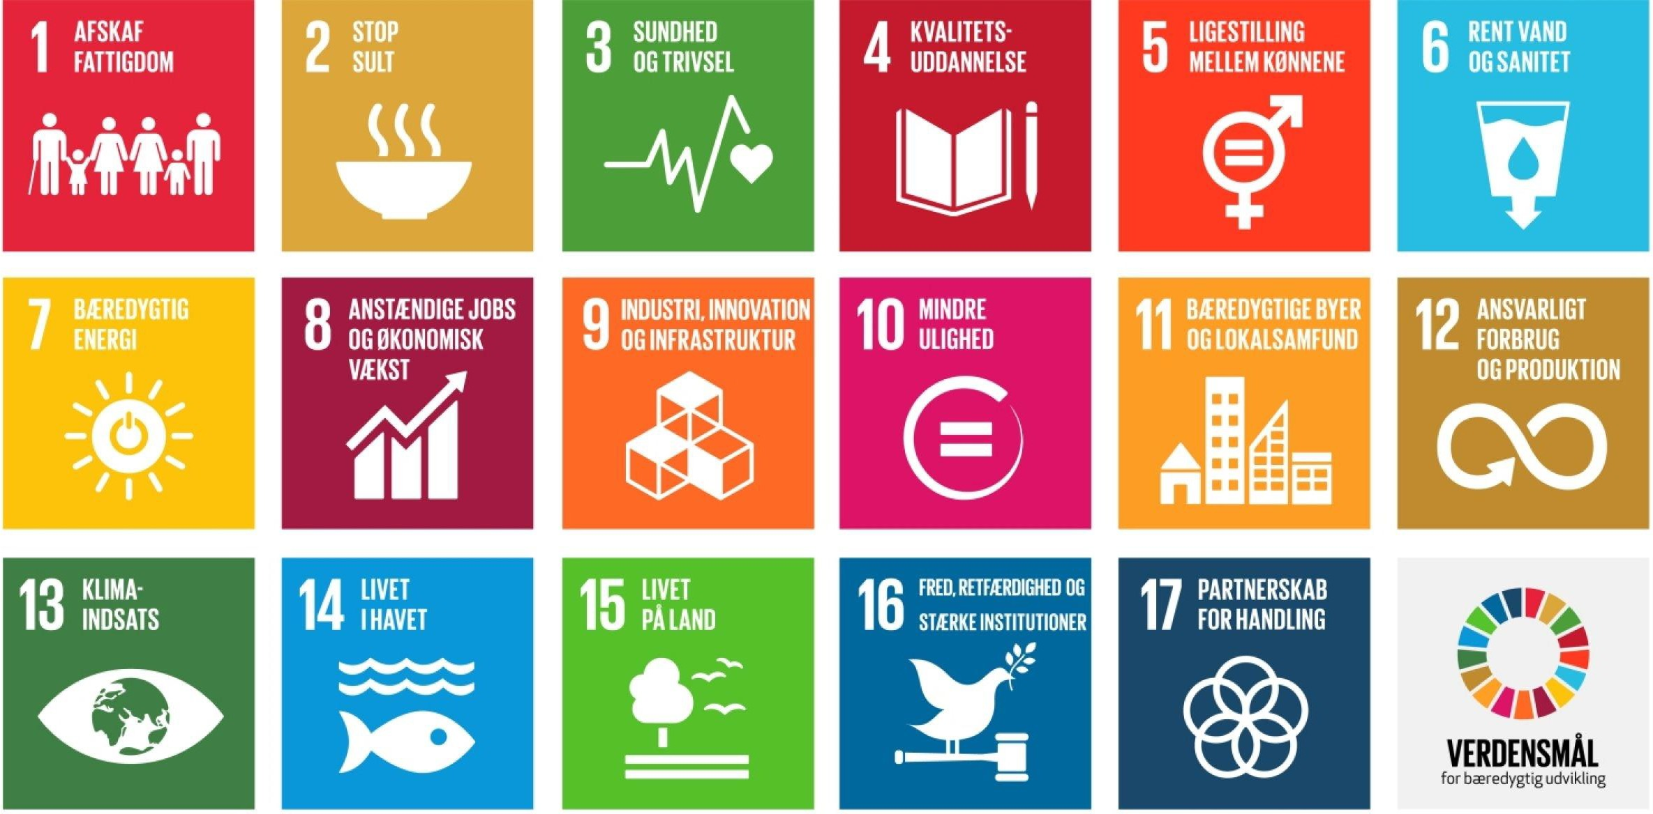

Slide 16
Embedding organic policy as a tool in RDP, and broader green, growth policies
State policy capacity, high level ministry leadership, administrative set-up
Balanced push-pull. But primary focus on market and sector development.
Policy as catalyst: key elements for success in Dk
Active use of
Action Plans
Capacity building in organic NGO = innovation in value chain, market dev.
Close collaboration with Organic NGO on policy

Slide 17
Drinking water
protection plan
Green Growth Strategy
Aquatic environment protection plan
Embedding Organics as a tool in broader policies
Green nation export branding strategy
Nature and biodiversity strategy
Rural development programme

Slide 18
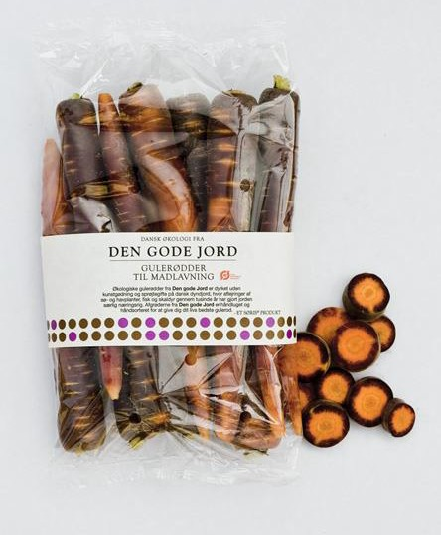
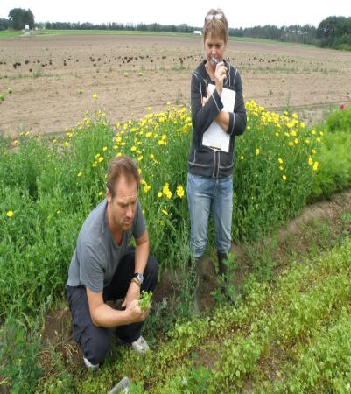
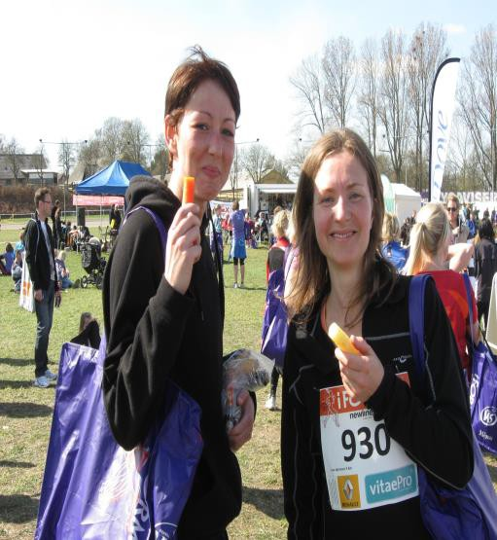
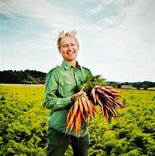
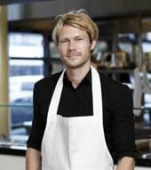
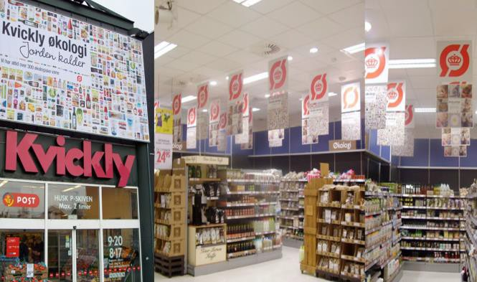
RDP: Market development!
Supermarkets
Food service
Export
Local markets
Consumer
awareness
Advice/training Investment
Product dev New crops
Sales channels
Farmer
Producer
consumer
Our organic sector strategy became:
The Organic Sector Development Scheme under RDP

Slide 19
Danish Organic Action Plans:
1987 (Organic law, standards/logo, council) 1995 (Primary focus: production, research)
1999 (Primary focus: market, research) 2008 (Research-based plan/vision)
2011 x2 (Export, Public kitchens)
2012 (RDP, Public kitchens)
2015 (Embedding, kitchens,RDP)
2017 (All fronts)
………………………………………………………………………………²…⁰…¹…⁸……^{(A}…^{l}…^{l} …^{fr}…º…^{n}…^{t}…^{s)}………………………..

Slide 20
Conversion support
PUSH: Stimulating production/conversion
Modest conversion/area support to farmers
Training, education, advisory services,
”conversion visits”
Investment
Investment on farms and in food companies.
Innovation
Research! Grassroots research. Produkt dev
Development of organic farm practices
………………………………………………………………………………………………………………………………………..

Slide 21
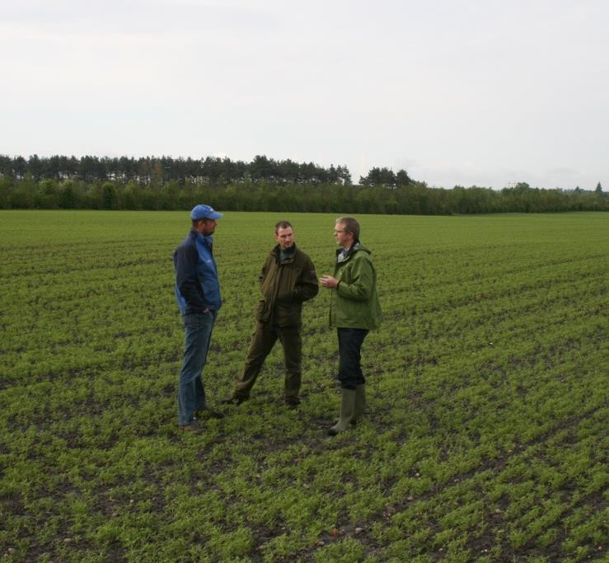
Cities team up with Organic Denmark to promote conversion locally
Partnerships with 26 municipalities on conversion to organic farming, especially in areas where local drinking water supplies and nature must be protected.
”Conversion checks” motivate farmers for organics.
………………………………………………………………………………………………………………………………………..

Slide 22
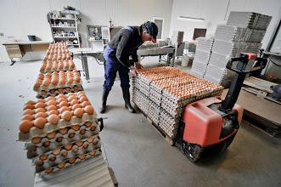
PUSH: Product development team creates new products, new jobs
Product development team creates new companies, new products and 25% job growth in small-medium organic companies.
Cooperation along product chains – new products, new markets, value added.
………………………………………………………………………………………………………………………………………..

Slide 23
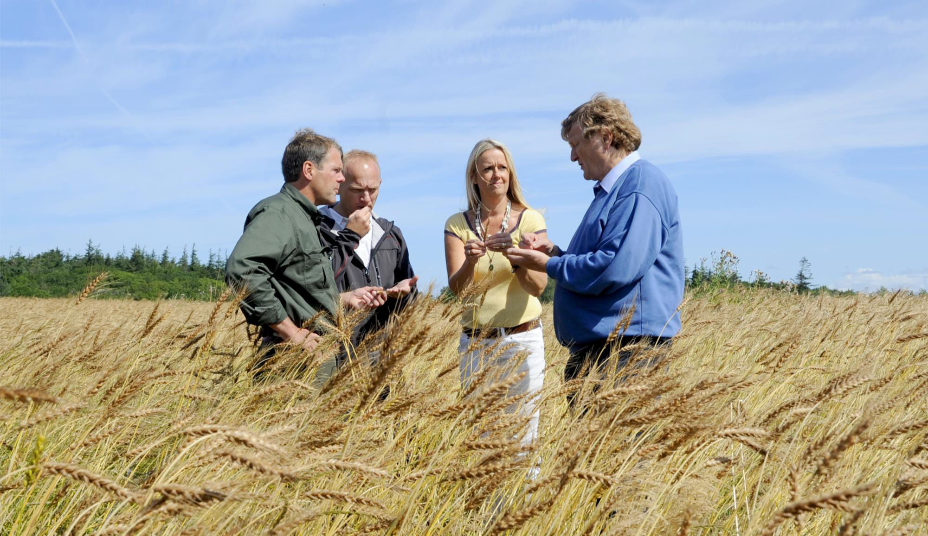
The entire food chain working together
Adding value. Solving problems:
Climate, quality…

Slide 24
National logo, inspection and certifying = trust
Farm levy funds support market development
Consumer information on organics
PULL:
Fokus on Market and Sector development
Export promotion
Public procurement goals and ressources
Capacity development in organic NGO = market development

Slide 25
PULL: Support strategic collaboration with retail
Inspiration
Collaboration: Top management, each chain
Assortment strategies
Product presentations
Advertising, in-store info, PR.
Central purchase & logistics
Producers
Chain stores
Consumers

Slide 26
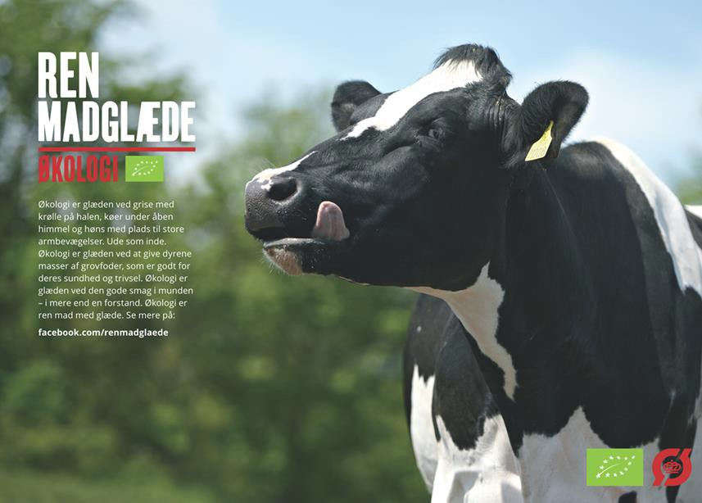
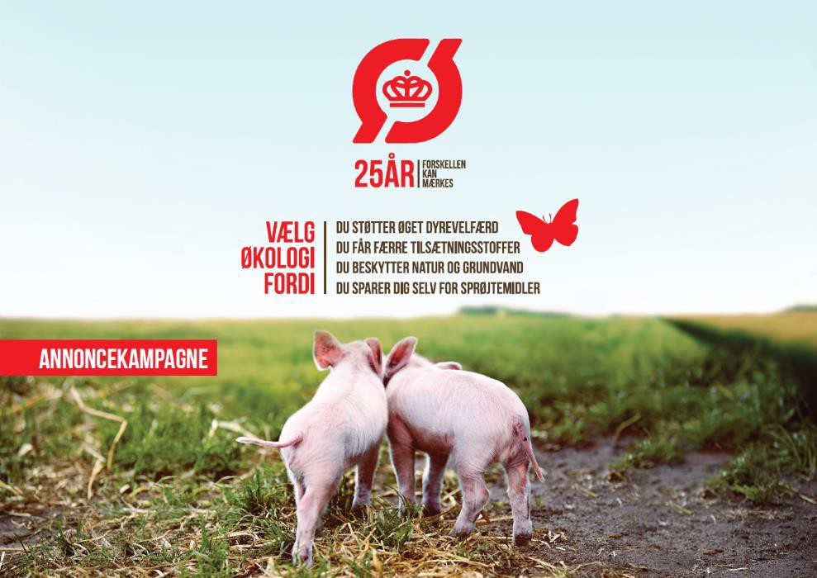
Positive communication to consumers
98 percent know our label
8 of 10 have high confidence
Organics is ”folkelig”
This adds to political goodwill
We dont talk about or criticise conventional farming
We dont force MPs to choose sides.
Building up the organic sector, does
not require that politicians choose sides.

Slide 27
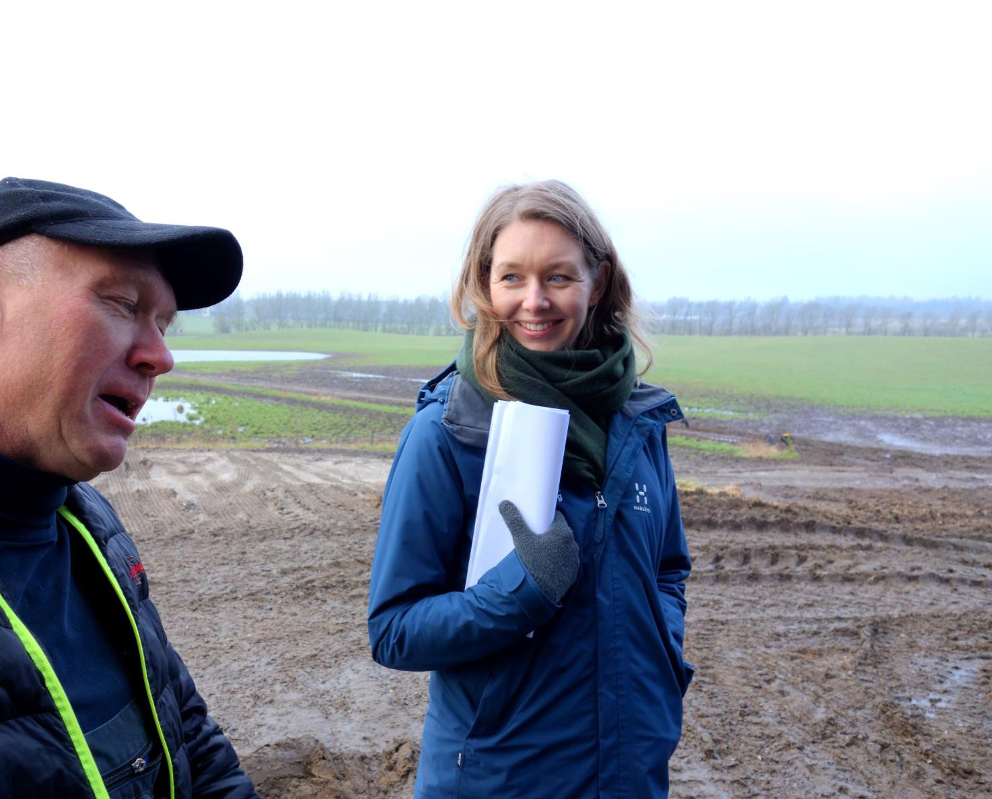
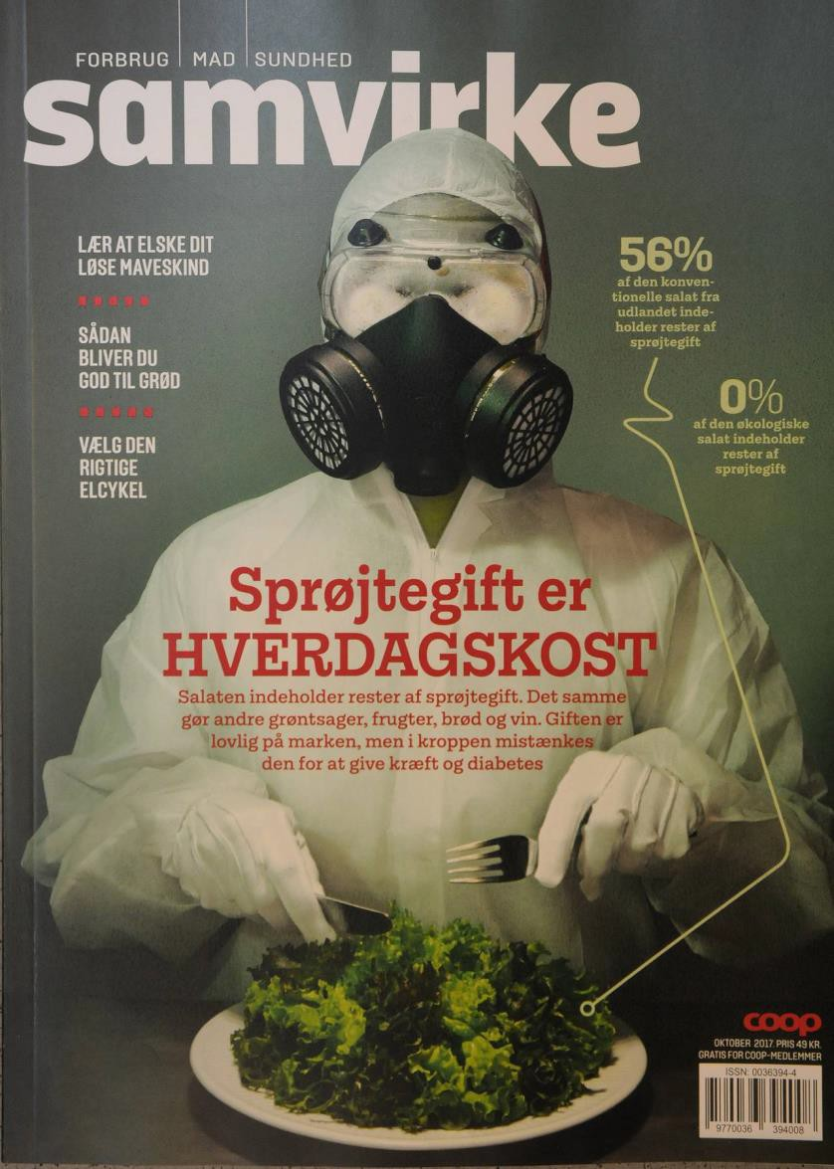
The people, the politicians, are always listening.
Our communication is not political, but
Our political communication is also for the consumer
We talk about the solutions we are creating.
We give hope – consumers and politicians can count on us!

Slide 28
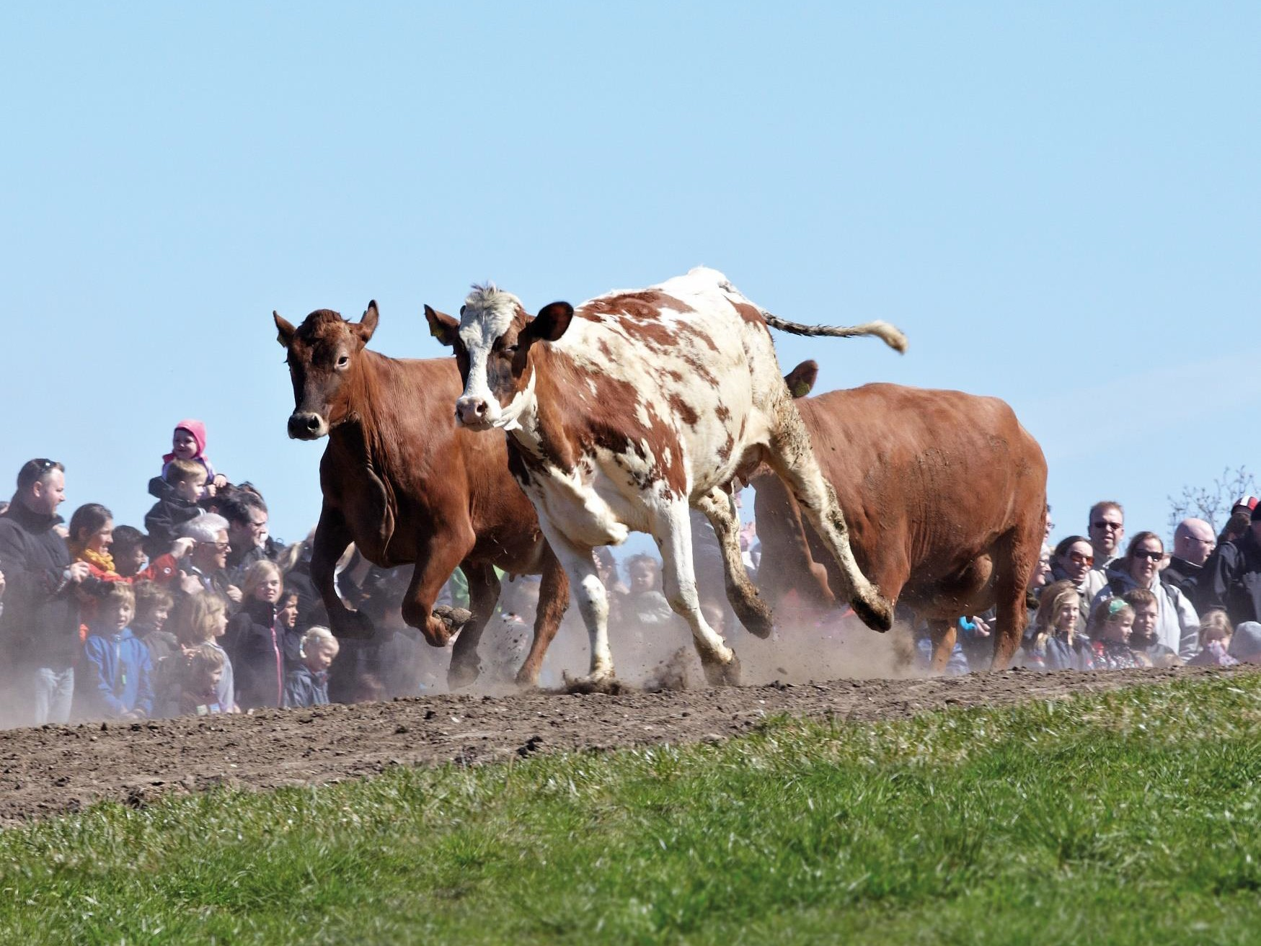
PULL: Support for consumer
awareness. Organic Day!
250.000 Danes go to the countryside to help welcome the organic cows out onto fresh grass for the first time after a long winter in the stable.
………………………………………………………………………………………………………………………………………..

Slide 29
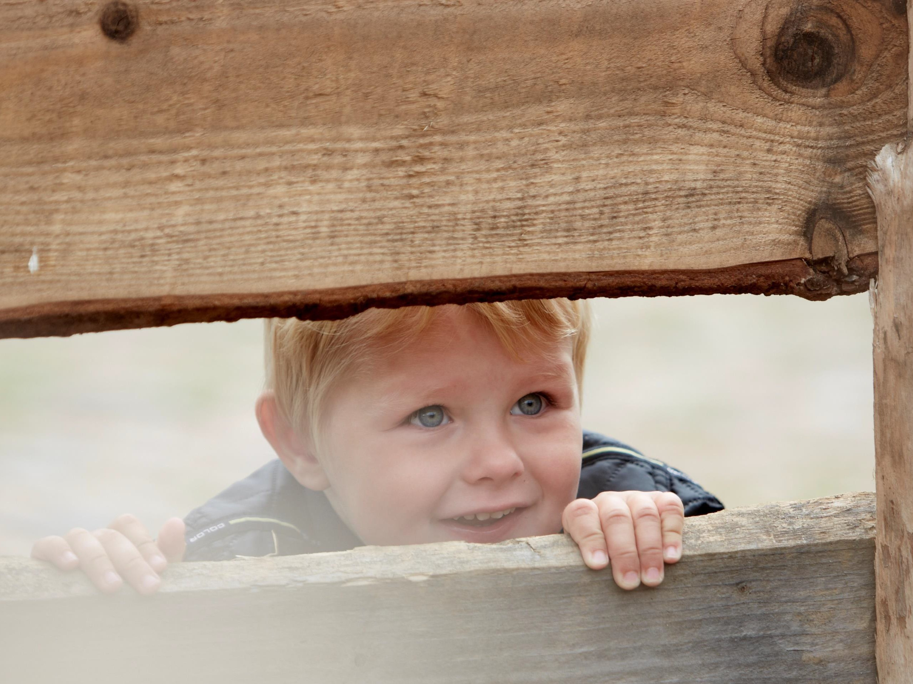
Visitors get an experience they can feel and remember.
The message: Organics set cows free.
………………………………………………………………………………………………………………………………………..

Slide 30
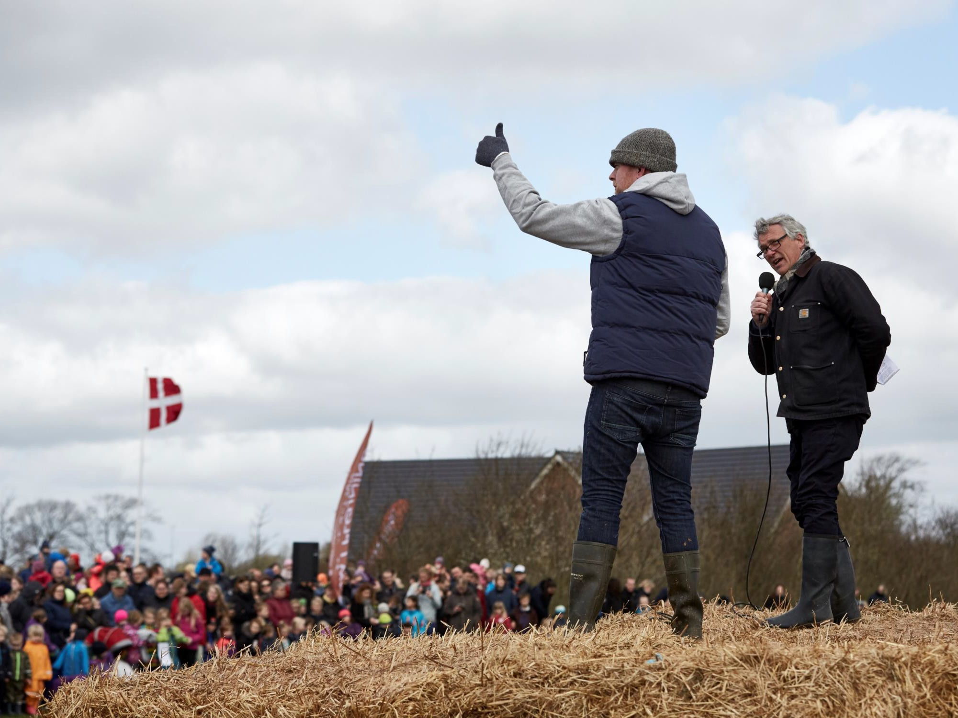
Farmers get the support they deserve.
………………………………………………………………………………………………………………………………………..

Slide 31
Politics create pull from market
Push/Pull from organic sector
National goal:
60 percent organic in all public kitchens
Guarantee for supply:
Collaboration in supply chain on product development & supply to kitchens
Political support and sector action create ”push and pull” for organic public kitchens
Financing:
Support for cities, hospitals etc for education in kitchens
Education, motivation in the kitchens:
Total conversion to healthier, organic and climate friendly food
National Organic
Cuisine Label:
For 30, 60, 90 %
organic in public & private kitchens
Education, motivation in food service companies:
Organic schools

Slide 32
Pull strategy 3
The organic cuisine labels
………………………………………………………………………………………………………………………………………..

Slide 33
Steady increase in organic cuisine labels in the public kitchens
3000
2500
2465
Antal spisemærker
2000
1947
1500
1429
1085
1000
603
500
304
0 12
36
94
0
2009 2010 2011 2012 2013 2014 2015 2016 2017 2018
År
………………………………………………………………………………………………………………………………………..

Slide 34
Push/pull from the organic sector 3:
Motivating leadership and frontline salespeople in food service firms
………………………………………………………………………………………………………………………………………..

Slide 35
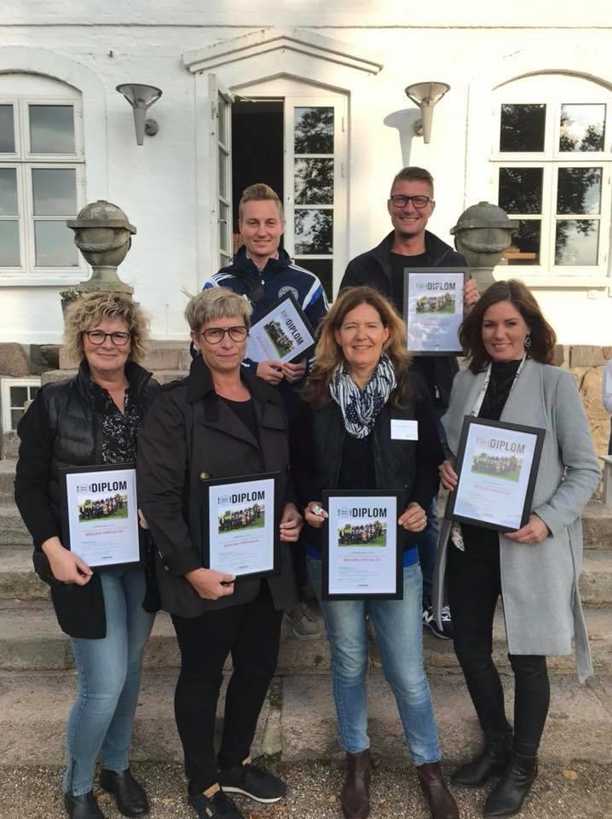
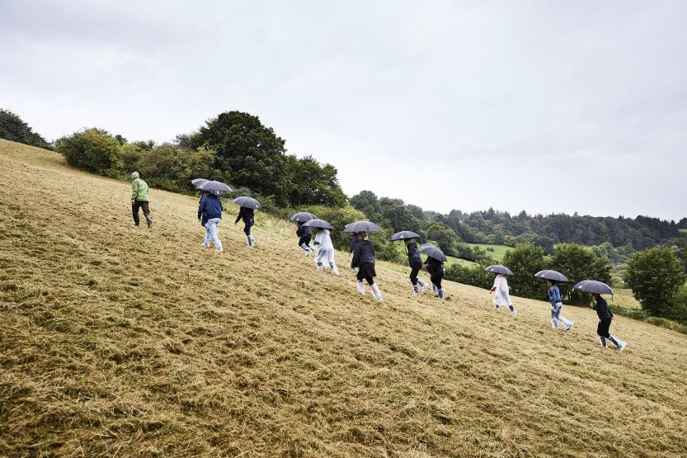
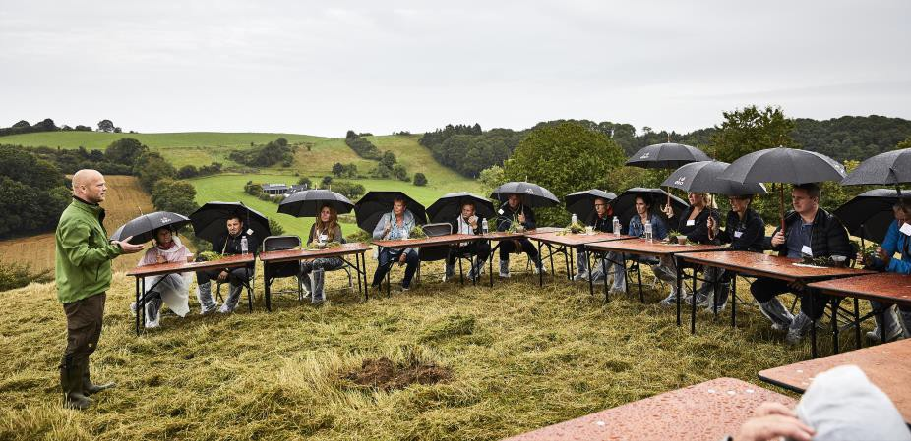
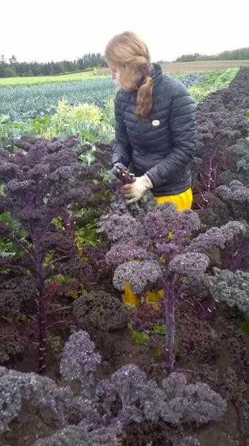
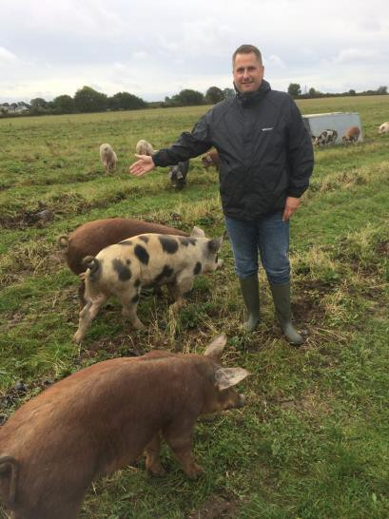
Its all about motivation:
Organics have to be experienced.
Getting close to ”the why” – what does organic farming mean for nature, animals, soil, climate.
Celebrating!

Slide 36
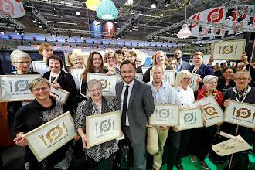
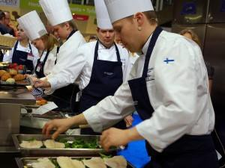
Organic sector creates momentum: Education and motivation in the kitchens!
Massive educational effort focussing on leaders and workers in the public kitchens; collaboration with their trade unions.
Mobile conversion trainers: Copenhagen House of Food; Øko + +
Broad agenda to increase respect for workers talent, as they ”make real food again”.
Reinforcement through celebrations.
………………………………………………………………………………………………………………………………………..

Slide 37
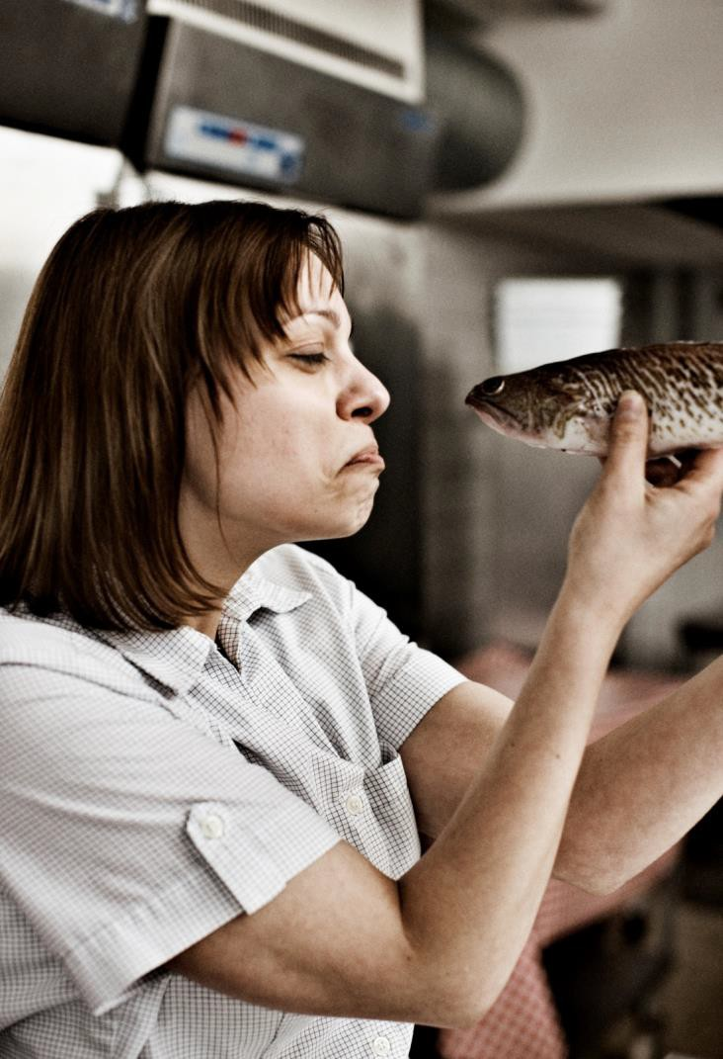
More greens; root veggies
Less meat
Food in season
Reduced waste
Better food
Organic within the same budget
………………………………………………………………………………………………………………………………………..

Slide 38
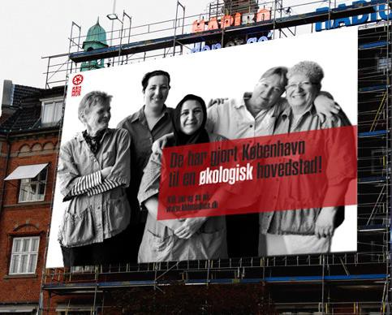
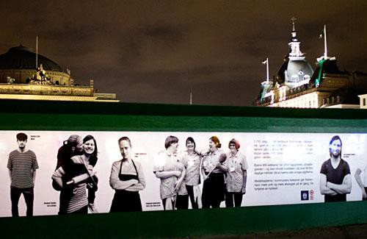
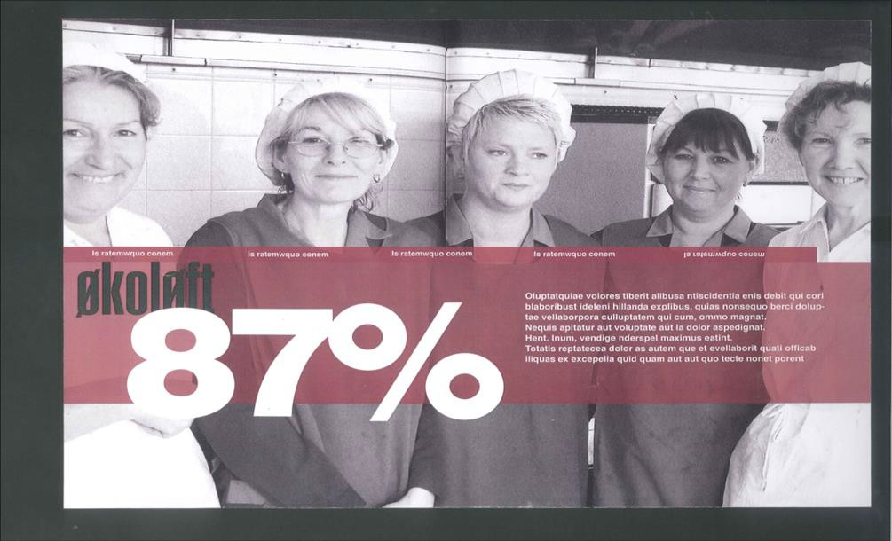
Its about the people: motivation!
………………………………………………………………………………………………………………………………………..

Slide 39
Tak for jeres opmærksomhed!
Thanks for listening! And for your efforts!
Contact us if we can help you pave the way to organic growth – with policy and market know-how.
Paul Holmbeck, director, Organic Denmark ph@okologi.dk
+45 28191962
www.organicdenmark.com
………………………………………………………………………………………………………………………………………..

